Slide 1




PHISHING AWARENESS TRAINING
CYBER SECURITY INTERNSHIP – CODEALPHA
ABHILASHA THAKUR

Slide 2

WHAT IS PHISHING?
Phishing is a cyber attack where attackers pretend to be a trusted source
(such as a bank, company, or website) to trick users into sharing sensitive information.
This information may include:
• Passwords
• OTPs
• Bank details
It usually happens through fake emails, messages, or websites that look real but are actually fraudulent.

Slide 3
TYPES OF PHISHING
• Email Phishing
• SMS Phishing (Smishing)
• Voice Phishing (Vishing)
• Fake Websites

Slide 4

EXAMPLE OF PHISHING EMAIL
"Your account will be blocked! Click here to verify."
Why it is phishing:
• Creates fear and urgency
• Contains fake link
• Tries to steal your information

Slide 5
HOW TO IDENTIFY PHISHING EMAILS
• Check sender email carefully
• Look for spelling mistakes
• Avoid clicking unknown links
• Urgent messages are suspicious

Slide 6
SOCIAL ENGINEERING
Social Engineering is a technique used by attackers to manipulate people into revealing confidential information.
Instead of hacking systems, attackers target human behavior by creating:
• Fear
• Urgency
• Trust
Example:
"I am calling from your bank. Please share your OTP to verify your account."
This tricks users into giving sensitive information like passwords, OTPs, or bank details.

Slide 7


REAL-WORLD EXAMPLES
Fake Login Phishing Attack

Slide 8
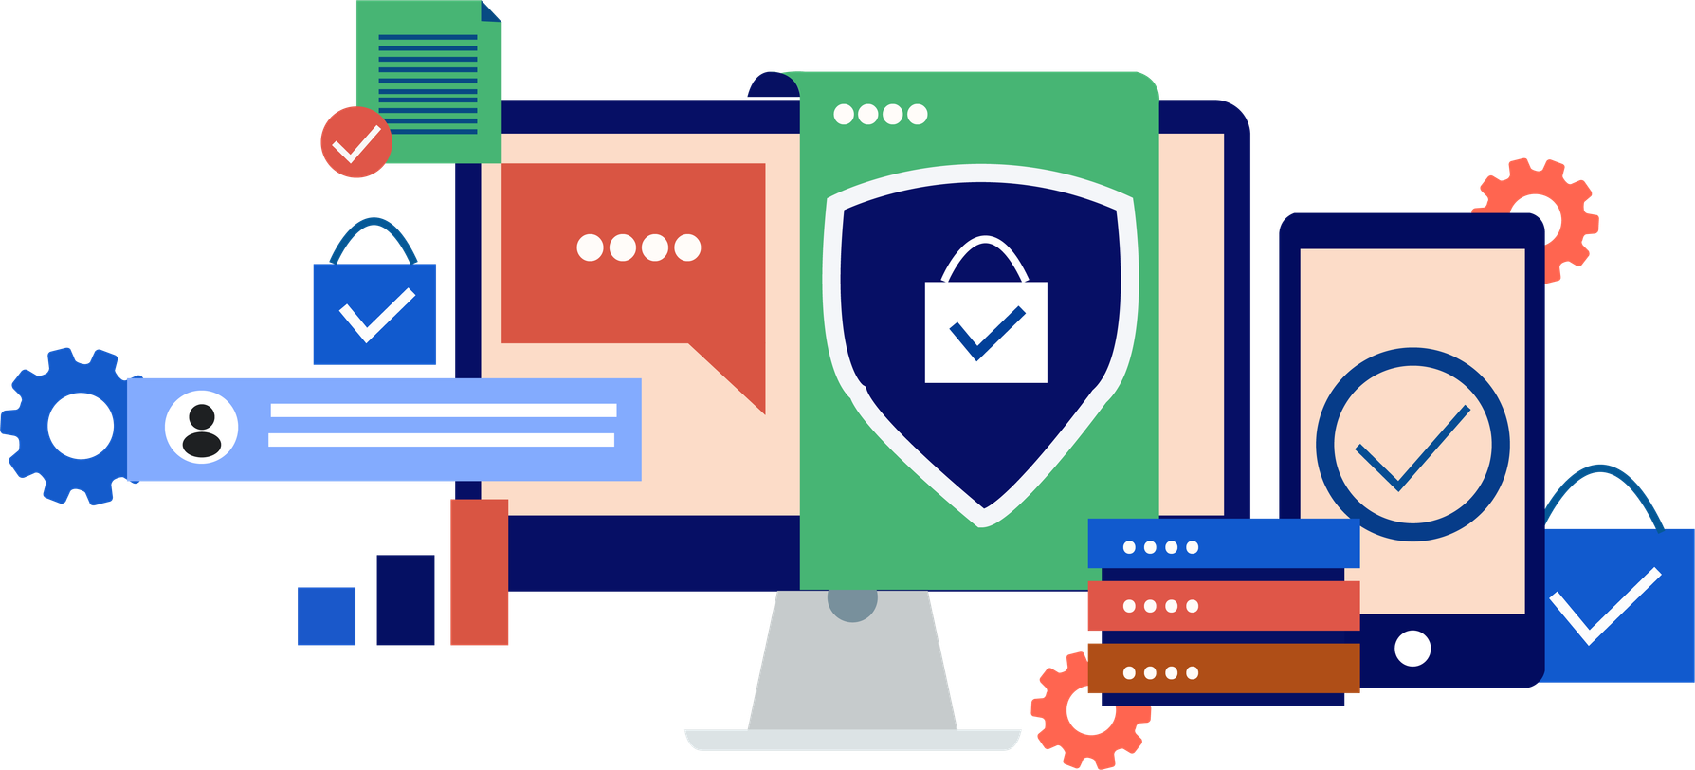
HOW TO STAY SAFE
• Never share OTP or password
• Use strong passwords
• Enable 2-factor authentication

Slide 9
BEST PRACTICES
• VERIFY LINKS BEFORE CLICKING
• Avoid unknown attachments
• Keep software updated

Slide 10

QUICK QUIZ
Q1: SHOULD YOU SHARE OTP?
❌ NO
Q2: WHICH IS CORRECT?
AMAZ0N.COM ❌
AMAZON.COM ✅
Q3: IS URGENT EMAIL SAFE?
❌ NO

Slide 11
CONCLUSION
PHISHING IS ONE OF THE MOST COMMON CYBER ATTACKS, BUT IT CAN BE PREVENTED WITH AWARENESS AND CAUTION.
BY UNDERSTANDING HOW PHISHING WORKS AND RECOGNIZING WARNING SIGNS, USERS CAN PROTECT THEIR PERSONAL AND FINANCIAL INFORMATION.
ALWAYS REMEMBER:
• THINK BEFORE YOU CLICK
• VERIFY BEFORE YOU TRUST
• NEVER SHARE SENSITIVE INFORMATION LIKE PASSWORDS OR OTPS
AWARENESS IS THE FIRST STEP TO STAYING SAFE ONLINE.

